Slide 1
Data-Link Layer: An Introduction
Covers Chapter# 09 from Text Book
Computer Communication & Networks
(CEN-223)
Fall 2022 (BSE-5A)

Slide 2
Logical Connections
In communication at the data-link layer:
One data-link layer is involved at the source and one at the destination.
Two data-link layers are involved at each router since Intermediate nodes need to both encapsulate and decapsulate.

Slide 3
Encapsulation is the process of adding additional information when data is traveling in OSI or TCP/IP model.
The additional information has been added on sender's side, starting from Application layer to Physical layer.
Encapsulation always takes place at the sender's side to send data properly.
This process can be explained with the four-layer TCP/IP model, with each step describing the role of the layer.

Slide 4
Decapsulation moves in the reverse order, from Layer 1 to Layer 4.
Decapsulation is the process of opening up encapsulated data that are usually sent in the form of packets over a communication network.
The intermediate points, such as routers, both decapsulation and encapsulation are carried out.
To forward the frame, the switch examines the destination MAC address and compares it to addresses found in the MAC address table.

Slide 5
Logical Connections (Cont.)
Q) Why need both encapsulation and decapsulation at each intermediate node?
Each link of the intermediate node may use different protocol, hence the requirement for different frame format.
Even when links use the same protocol, encapsulation and decapsulation are still needed since the link-layer addresses are different.
A link-layer address is called a link address, called a physical address, and sometimes a MAC address.

Slide 6
Sublayers
The data-link layer is divided into two sub-layers:
Data-link control (DLC), deals with all point-to-point and multipoint links (broadcast links).(Flow control)
Media access control (MAC), deals with broadcast links. (Access Control)

Slide 7
Logical Link Control (LLC) controls the synchronization, flow control, and error checking functions of the data link layer.
Media Access Control (MAC) sublayer provides control for accessing the transmission medium.

Slide 8
A network address is an identifier for a node or host on a telecommunications network.
Network addresses are designed to be unique identifiers across the network, although some networks allow for local, private addresses, or locally administered addresses that may not be unique.
The physical address -- which is also called a media access control, or MAC, address -- identifies a device to other devices on the same local network. The internet address -- or IP address -- identifies the device globally. A network packet needs both addresses to get to its destination.

Slide 9
Addressing
The source and destination IP addresses define communication between two ends but cannot define the links which the data should pass through.
A datagram contains enough information to be routed from its source to its destination.
Datagram is packet with IP header. A packet is a block of data.
The datagram is encapsulated into a frame, where two data-link layer addresses are added.
While a packet is the unit of data used in the network layer, a frame is the unit of data used in the OSI model's data link layer.
Types of link-layer addresses:
Unicast Address: one-to-one communication.
Multicast address: one-to-many communication.
Broadcast address: one-to-all communication.

Slide 10
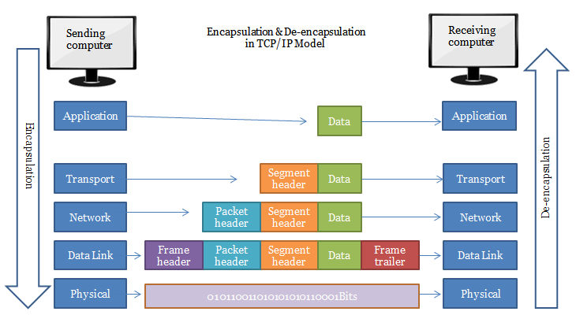

Slide 11
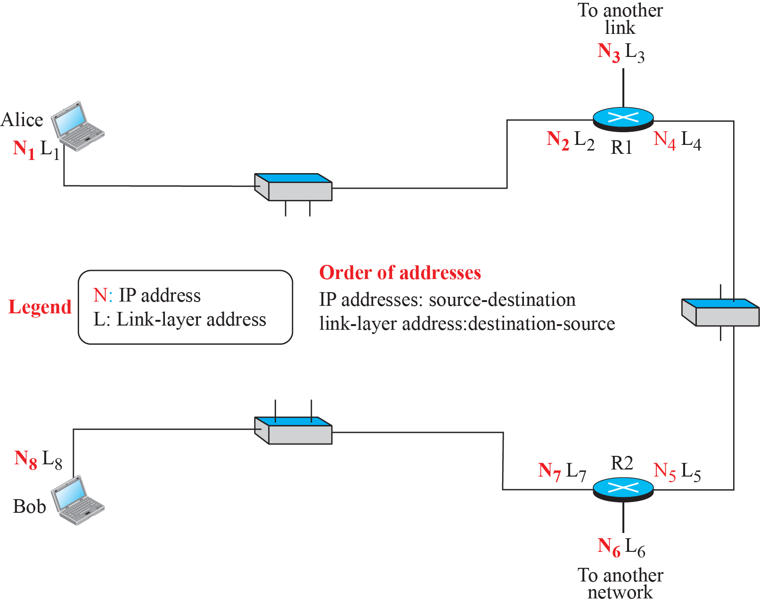
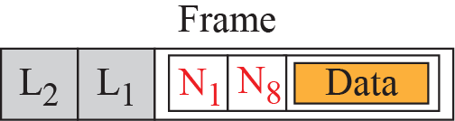
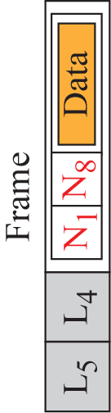
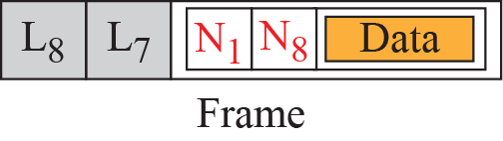

Slide 12
Address Resolution Protocol
Address Resolution Protocol (ARP): is an auxiliary protocol defined in the network layer that maps the IP addresses into a link-layer address.
Q) Why do we need the ARP protocol?
Any time a node has an IP datagram to send to another node in a link, it has the IP address of the receiving node.
However, the IP address of the next node is not helpful in moving a frame through a link, where we need the link-layer address of the next node. For that, ARP is used.

Slide 13
Address Resolution Protocol (Cont.)
If host/router needs to find the link-layer address of another host/router in its network:
Send an ARP request packet through broadcast.
ARP request packet includes: (link-layer and IP addresses of sender) and (IP address of receiver).
Every host/router that receives ARP request processes the packet.
Only intended recipient sends back an ARP response packet through unicast.
ARP response packet includes (recipient IP and link-layer addresses)

Slide 14
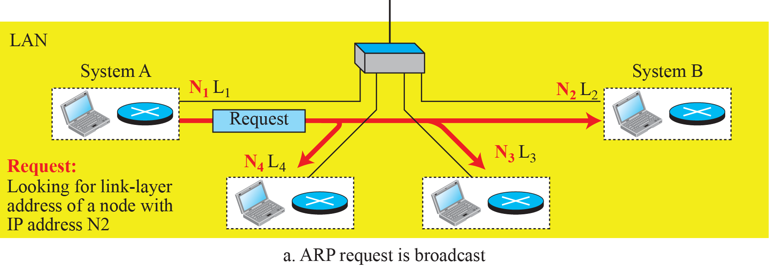
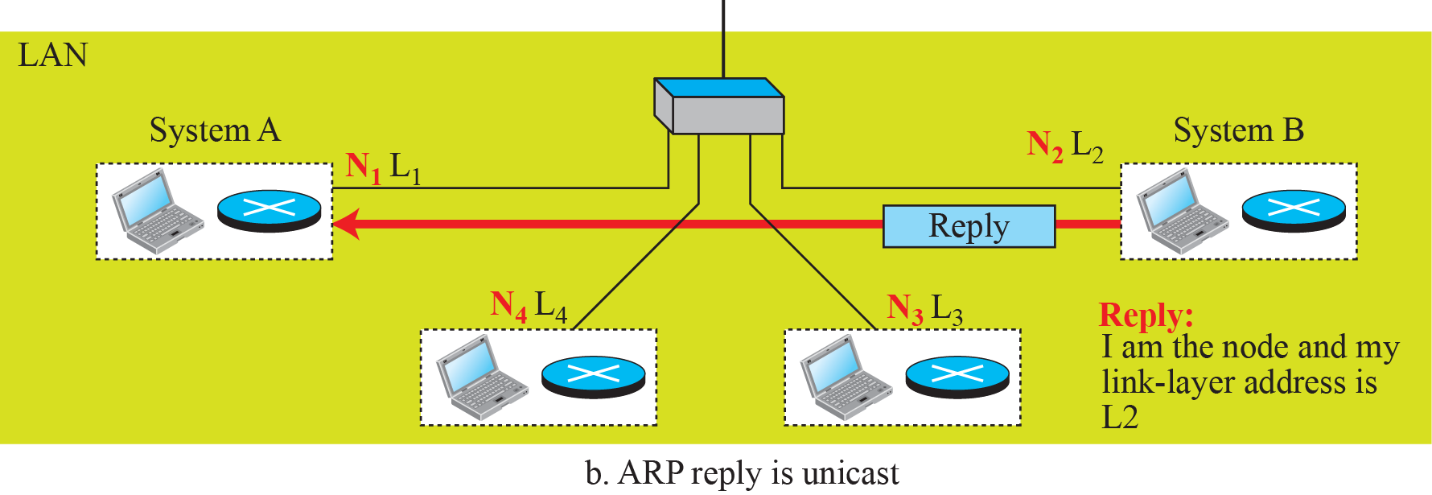

Slide 15
Data-Link Layer: Media Access Control (MAC)
Covers Chapter# 12 from Text Book

Slide 16
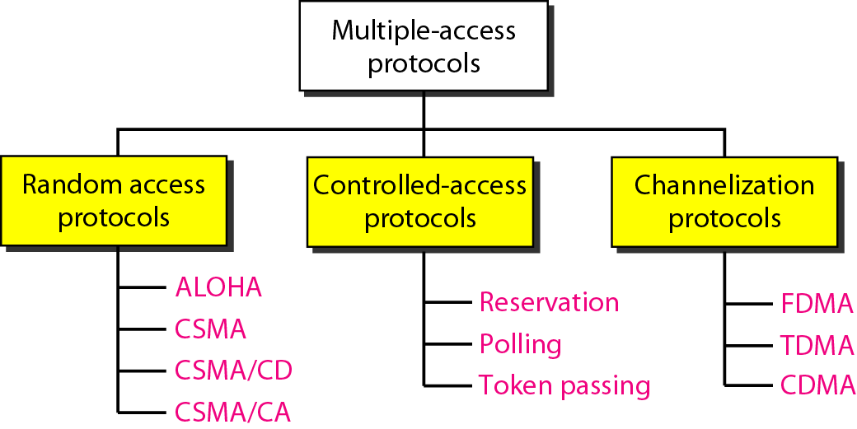
Media Access Control (MAC)
Protocols designed to handle access to shared link belong to the MAC sublayer, and can be categorized into three subgroups:

Slide 17
Channelization
Channelization: is channel partitioning and a multiple access method in which available bandwidth of a link is shared in frequency, time or through code among different nodes.
Three channelization protocols are:
Frequency-division multiple access (FDMA)
Time-division multiple access (TDMA)
Code-division multiple access (CDMA)

Slide 18
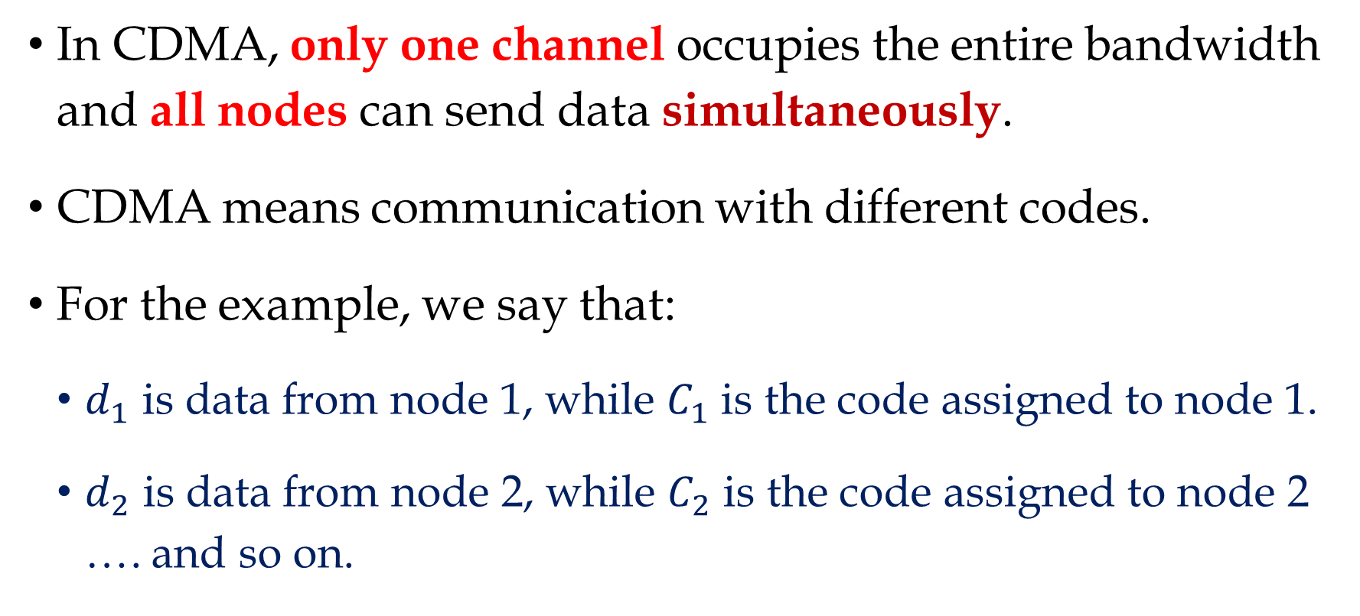
CDMA
In CDMA, only one channel occupies the entire bandwidth and all nodes can send data simultaneously.
CDMA means communication with different codes.
For the example, we say that:
$d_{1}$ is data from node 1, while $C_{1}$ is the code assigned to node 1.
$d_{2}$ is data from node 2, while $C_{2}$ is the code assigned to node 2 …. and so on.

Slide 19
CDMA (Cont.)
In CDMA, each node is assigned a code, which is a sequence of numbers called chips.
These sequences are carefully selected (called orthogonal sequences).
In orthogonal sequences, each sequence is made of N elements, where N is number of possible nodes.
If a node is sending bit 0, it encodes it as -1.
If a node is sending bit 1, it encodes it as +1.
If a node is idle, it sends no signals, which is interpreted as 0.

Slide 20
CDMA (Cont.)
Chip sequences
Data representation in CDMA

Slide 21
CDMA (Cont.)
Arithmetic rules of orthogonal sequence:
When multiplying a sequence by a scalar value, every element in sequence is multiplied by that scalar value.
2  [+1 +1 -1 -1] = [+2 +2 -2 -2]
When multiplying two equal sequences, every element is multiplied by its corresponding element. Adding the multiplication results would generate the value N.
[+1 +1 -1 -1]  [+1 +1 -1 -1] = +1 +1 +1 +1 = 4

Slide 22
CDMA (Cont.)
When multiplying two different sequences, every element is multiplied by its corresponding element. Adding the multiplication results would generate the value 0.
[+1 +1 -1 -1]  [+1 +1 +1 +1] = +1 +1 -1 -1 = 0
When adding two sequences, every element is added to its corresponding element. This would generate another sequence.
[+1 +1 -1 -1] + [+1 +1 +1 +1] = [+2 +2 0 0]

Slide 23
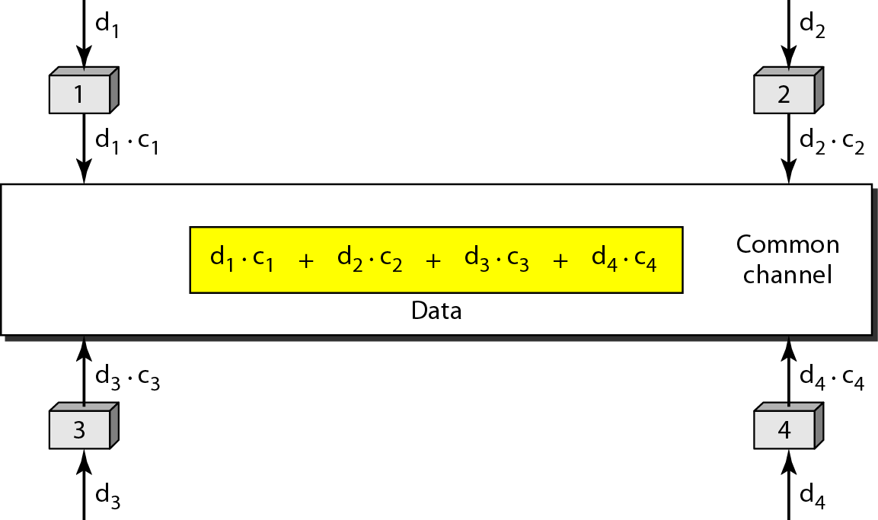
CDMA (Cont.)

Slide 24
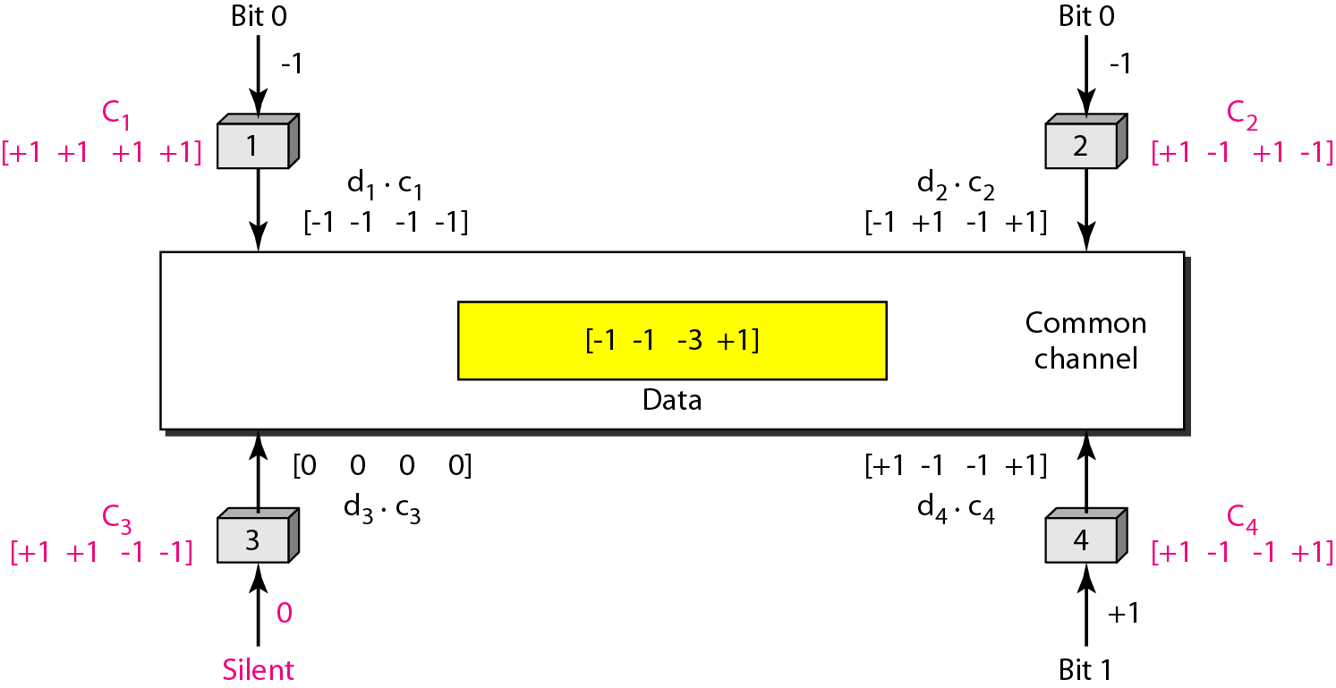
CDMA (Cont.)

Slide 25
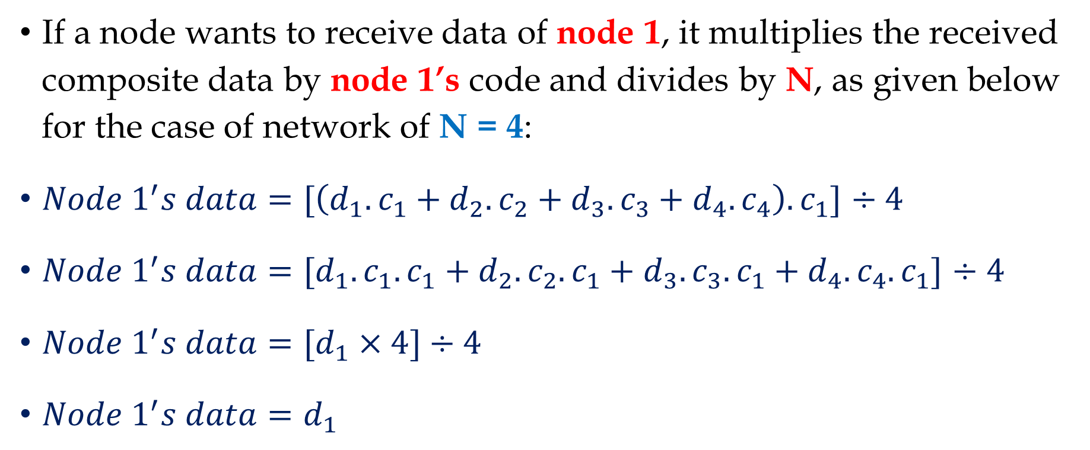
CDMA (Cont.)
If a node wants to receive data of node 1, it multiplies the received composite data by node 1’s code and divides by N, as given below for the case of network of N = 4:
$Node 1^{′}s data=[\left(d_{1}.c_{1}+d_{2}.c_{2}+d_{3}.c_{3}+d_{4}.c_{4}\right).c_{1}]$ $÷4$
$Node 1^{′}s data={[d}_{1}.c_{1}.c_{1}+d_{2}.c_{2}.c_{1}+d_{3}.c_{3}.c_{1}+d_{4}.c_{4}.c_{1}]$ $÷4$
$Node 1^{′}s data=[d_{1}×4]÷4$
$Node 1^{′}s data=d_{1}$

Slide 26
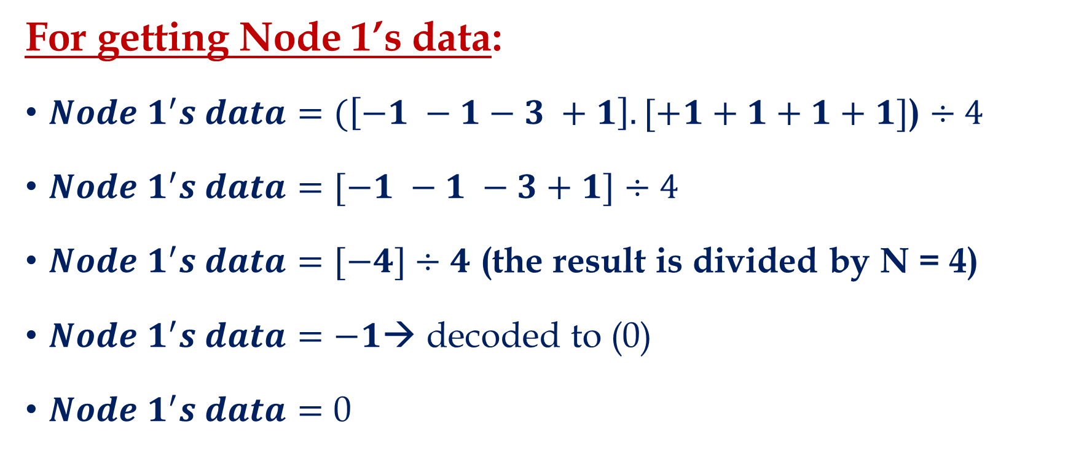
CDMA (Cont.)
For getting Node 1’s data:
$Node 1^{′}s data=(\left[−1 −1−3 +1\right].[+1+1+1+1]$) $÷4$
$Node 1^{′}s data=[−1 −1 −3+1]$ $÷4$
$Node 1^{′}s data=[−4]÷4$ (the result is divided by N = 4)
$Node 1^{′}s data=−1$→ decoded to (0)
$Node 1^{′}s data=$ 0

Slide 27
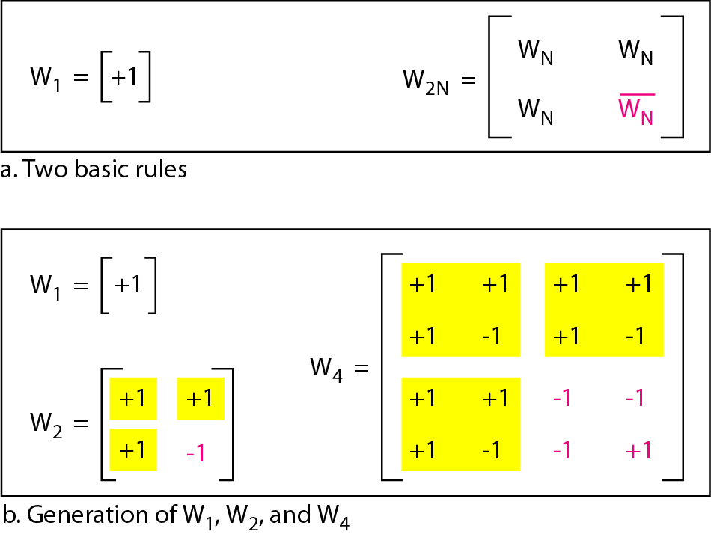
CDMA (Cont.)
Walsh table is a two dimensional table with equal number of rows and columns.
Walsh table is used to generate the code sequences, where each “row” is a sequence.

Slide 28
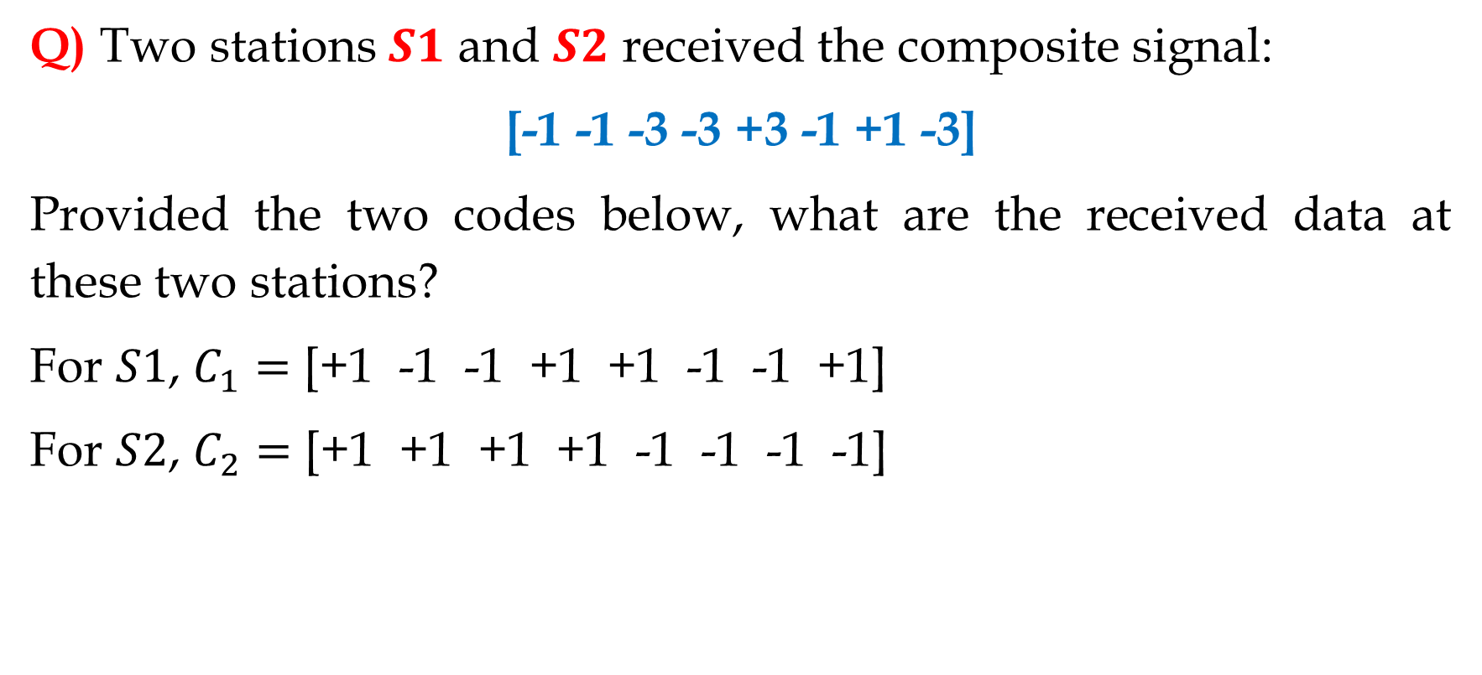
CDMA (Cont.)
Q) Two stations $S1$ and $S2$ received the composite signal:
[-1 -1 -3 -3 +3 -1 +1 -3]
Provided the two codes below, what are the received data at these two stations?
For $S1$, $C_{1}=$ [+1 -1 -1 +1 +1 -1 -1 +1]
For $S2$, $C_{2}=$ [+1 +1 +1 +1 -1 -1 -1 -1]

Slide 29
Thank You!

